Slide 1
Violent Crimes Predictors
Chloe Dinh,
Matyas Chlebovsky

Slide 2
Data Understanding
Data from 1990 US Census, 1995 FBI Crime Report, and 1990 US Law Enforcement Management and Administrative Statistics Survey
Data
General Demographics (Age, Income, Race, Employment)
Crime (Murders, Rapes, Assaults, Robberies, and 4 other)
Immigration, Police Department, Housing, and others
Original Data => 2215 observations and 147 variables
125 Predictive, 4 Non-Predictive, 18 Potential Dependent
Final Data => 1901 observations and 31 variables
30 Predictive, 0 Non-Predictive, 1 Dependent
Notes:
Dataset created by Michael Redmond, culled from 1990 US Census, 1995 US FBI Uniform Crime Report, 1990 US Law Enforcement Management and Administrative Statistics Survey, available from ICPSR at U of Michigan.
The FBI notes that use of this data to evaluate communities is over-simplistic, as many relevant factors are not included. For one example, communities with large numbers of visitors will have higher per capita crime (measured by residents) than communities with fewer visitors, other things being equal.

Slide 3
Business Understanding
Lowering Crime Rates
Helping Under-Developed Communities
Establish Policies to Assist Minorities
Lowering Crime Rates
Helping Under-Developed Communities
Establish Policies to Assist Minorities

Slide 4
Data Exploration
Communities in States
California – 279
New Jersey – 211
Texas – 123
Frequent City Names
Greenville (5)
Jacksonville (5)
Albany (4)
Auburn (4)
Springfield (4)
Population
Mean = 52,499 Std. Dev. = 206,117
Murders per 100,000
Mean = 5.9 Std. Dev. = 9
Rapes per 100,000
Mean = 36 Std. Dev. = 34
Auto Theft per 100,000
Mean = 483 Std. Dev. = 506
Notes:
Police Cars Available -

Slide 5
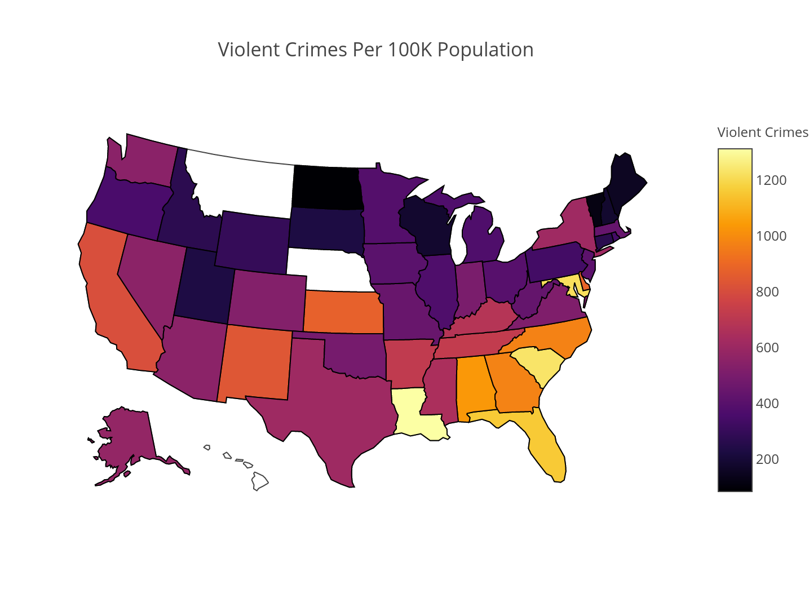
Violent Crimes per 100,000 Population

Slide 6
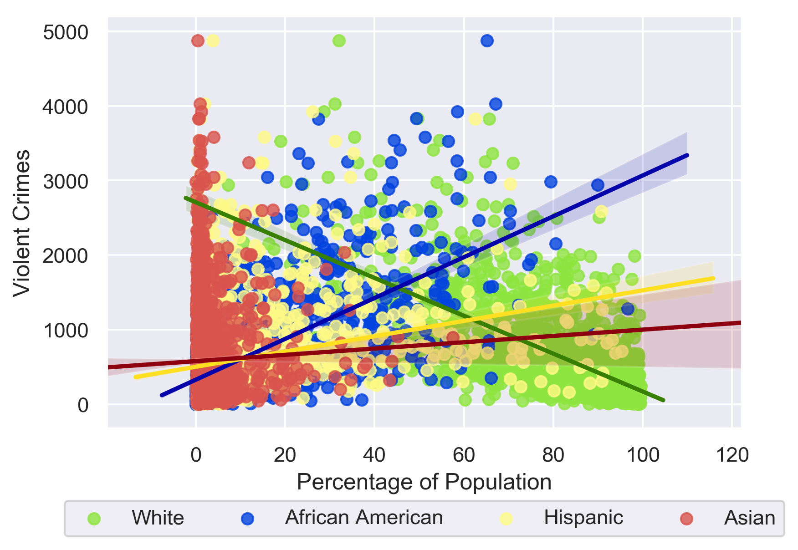
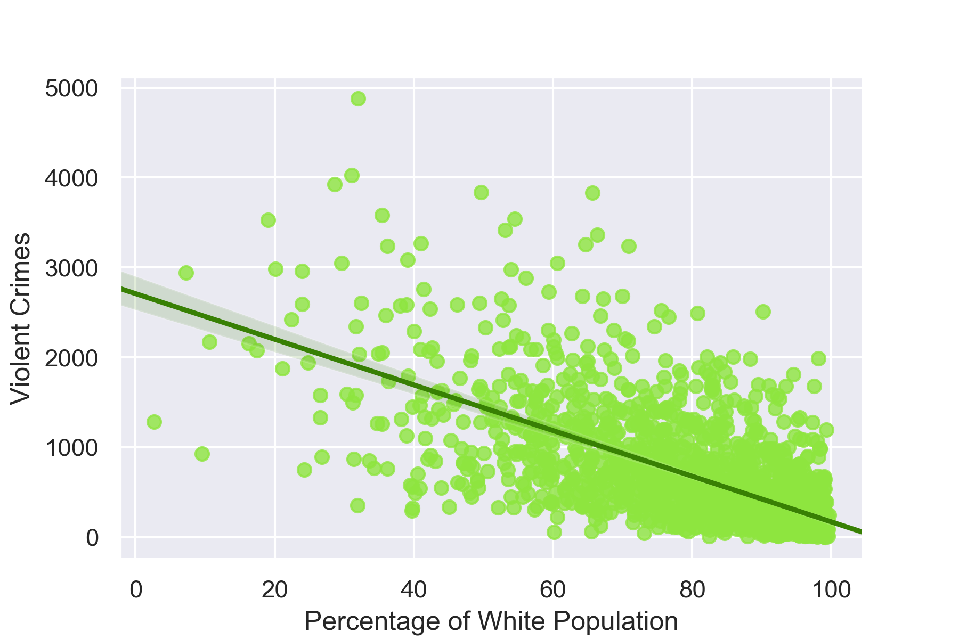
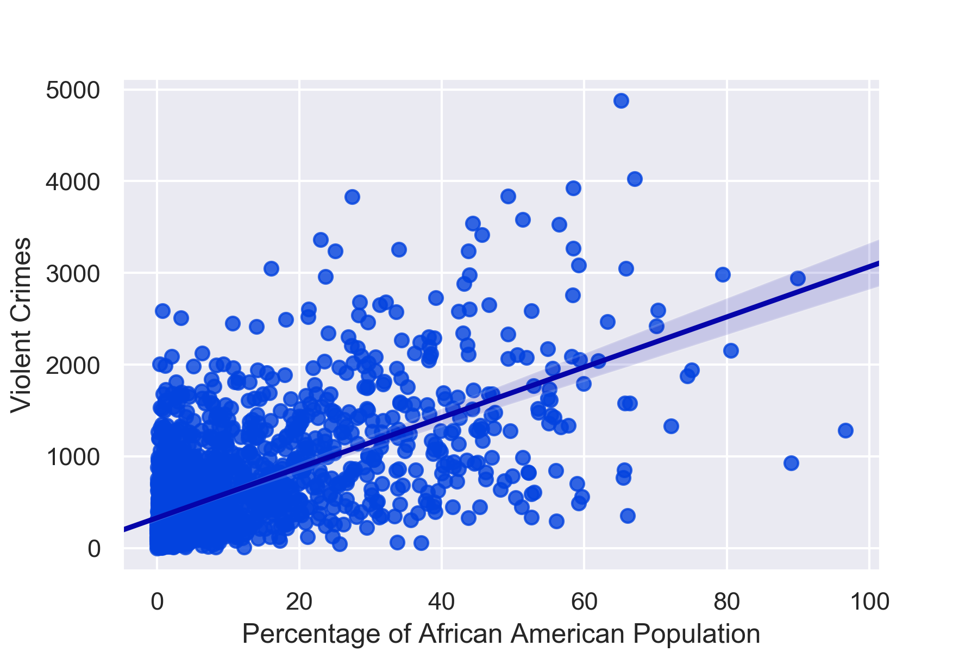
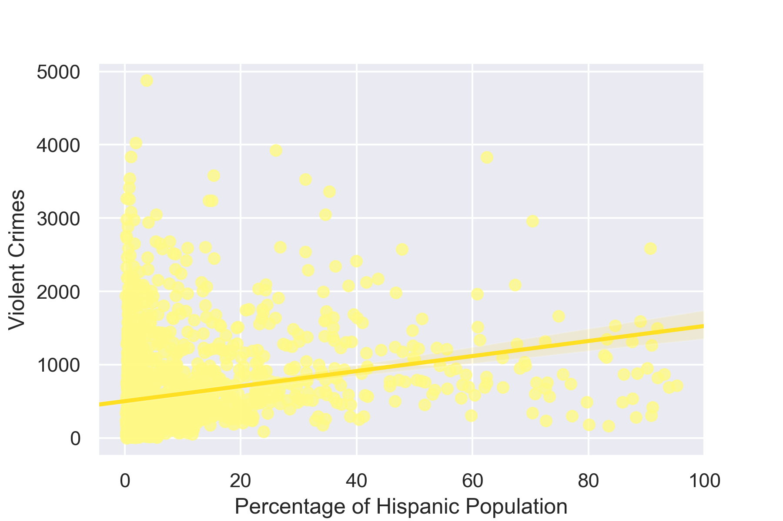
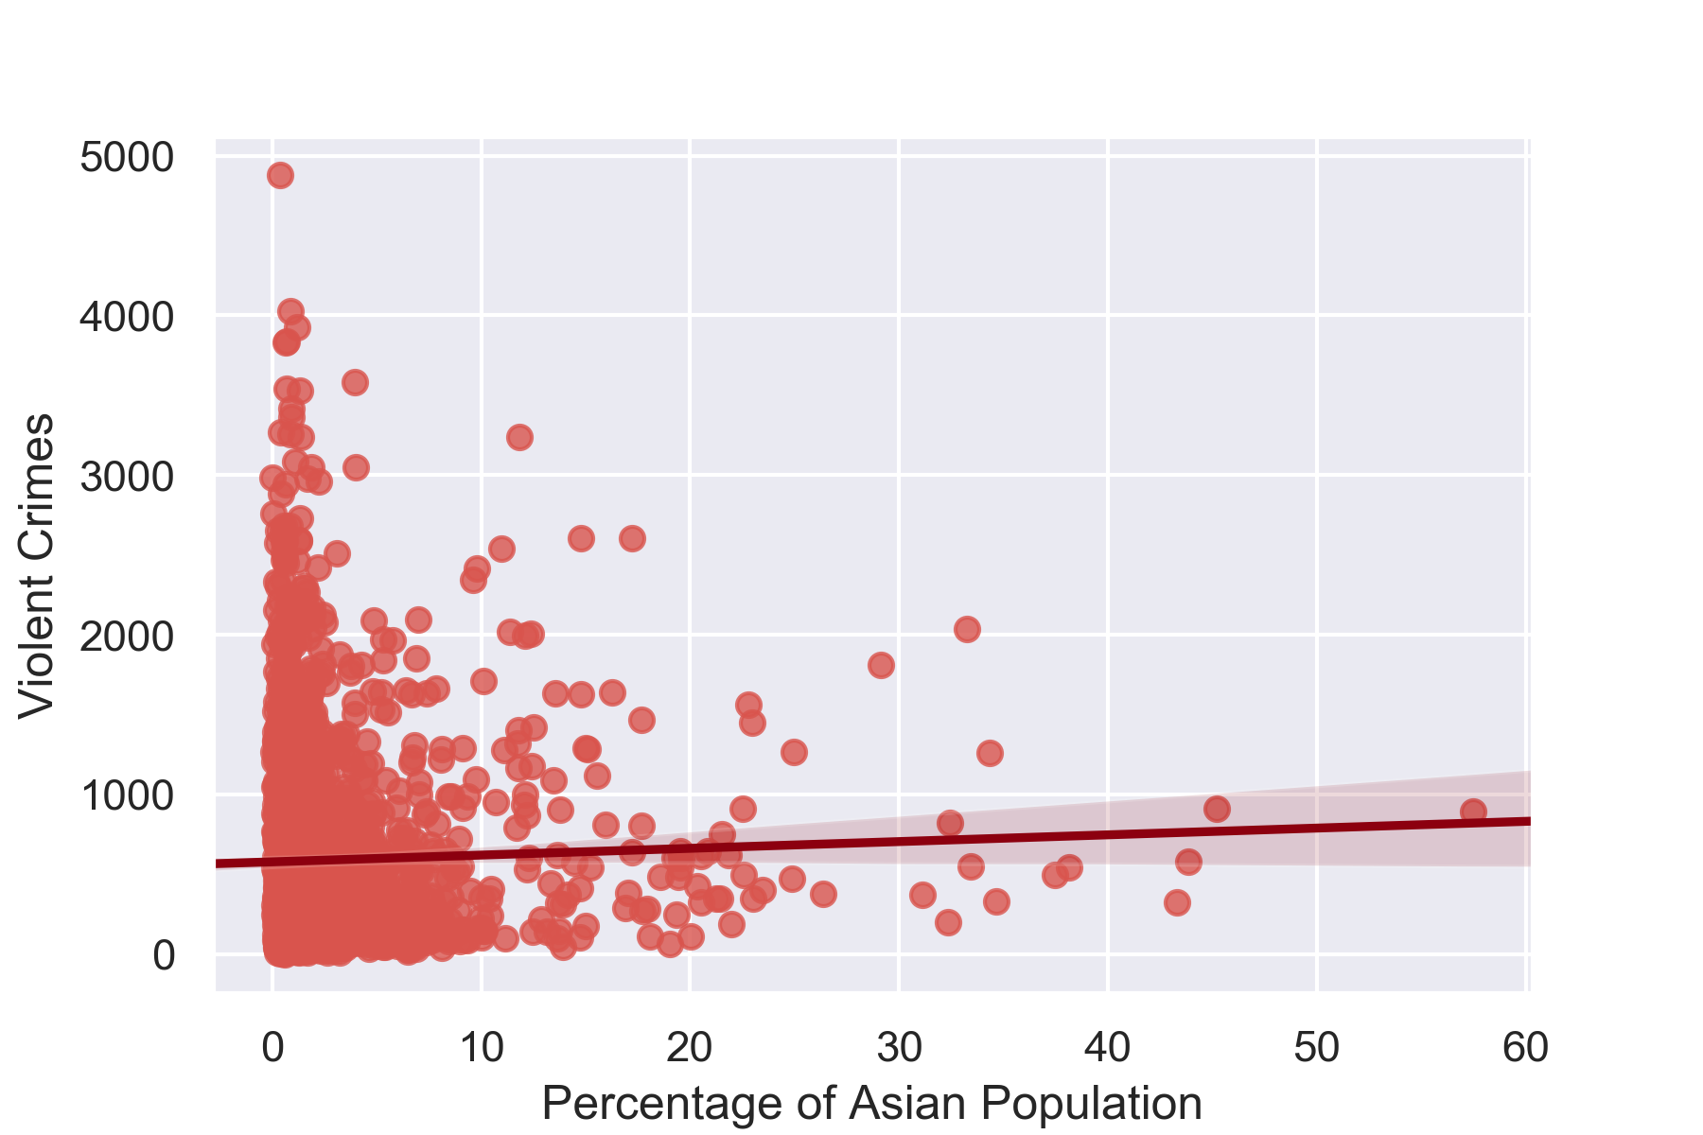
Violent Crimes per Race Percentage of Population

Slide 7
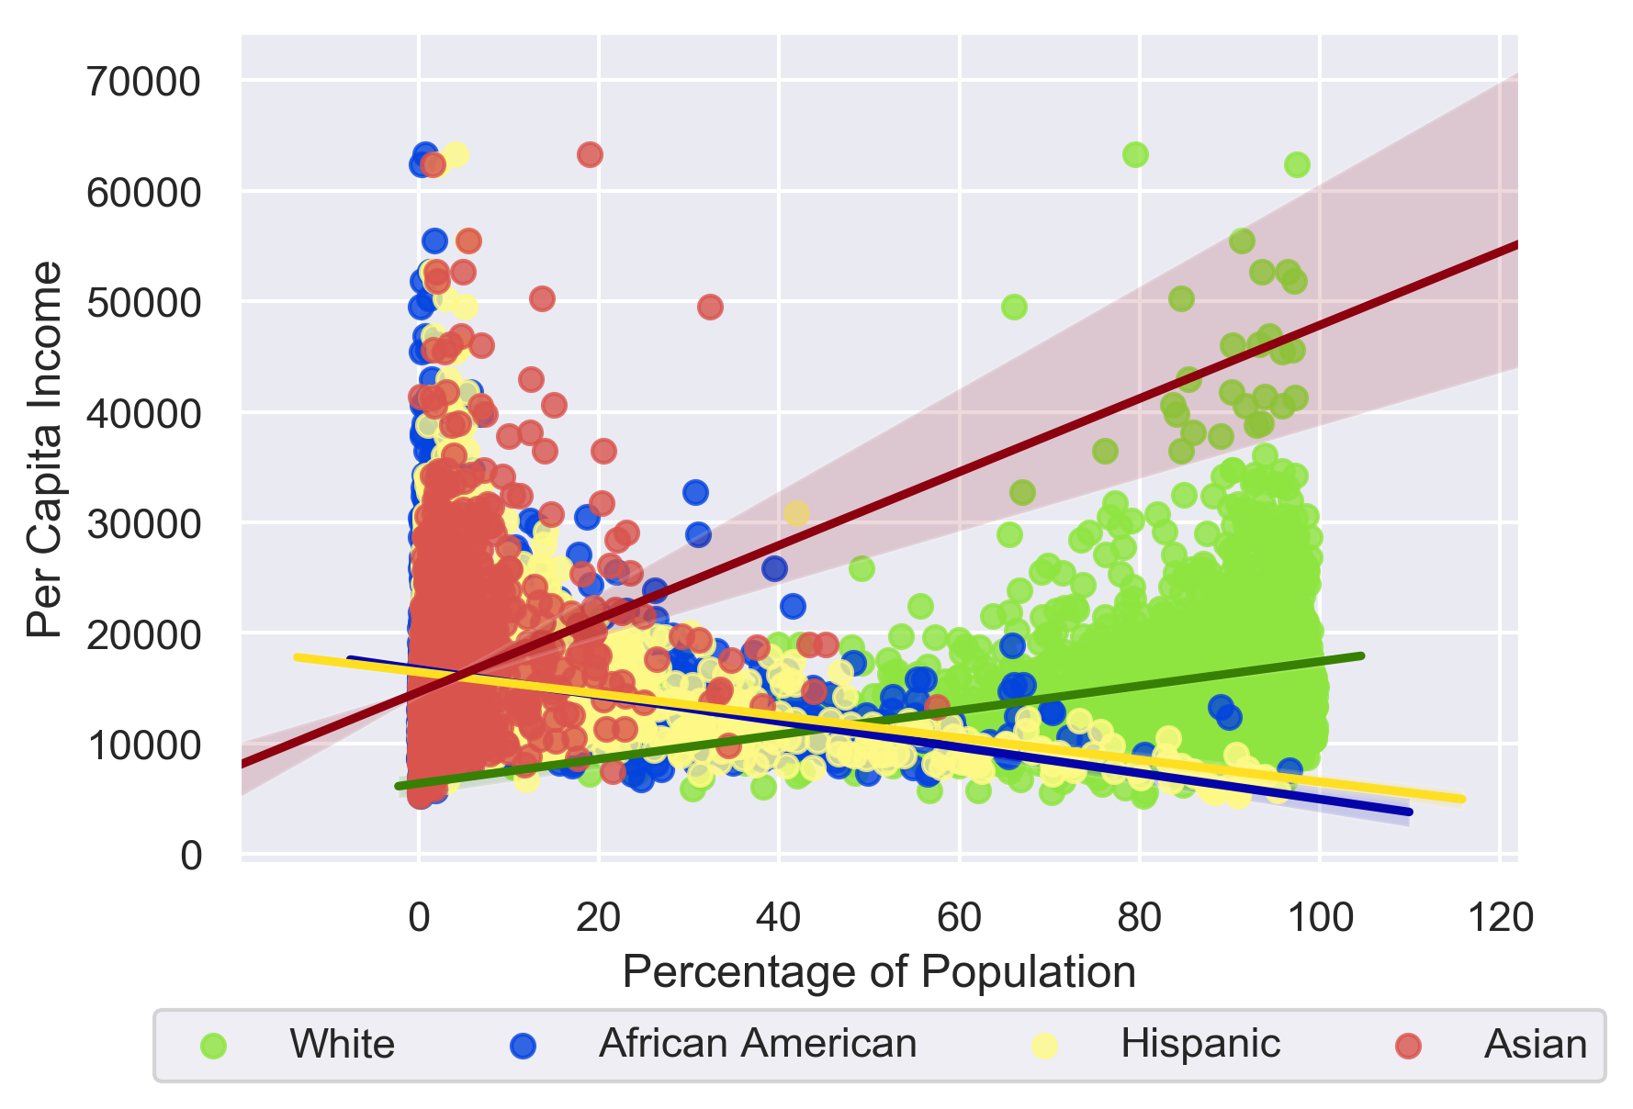
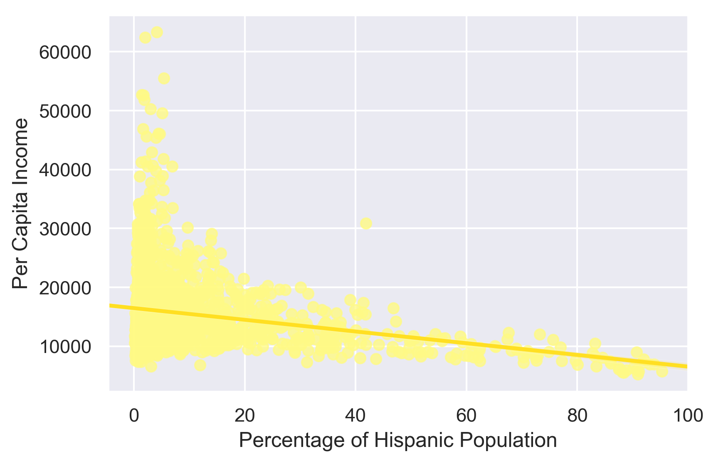
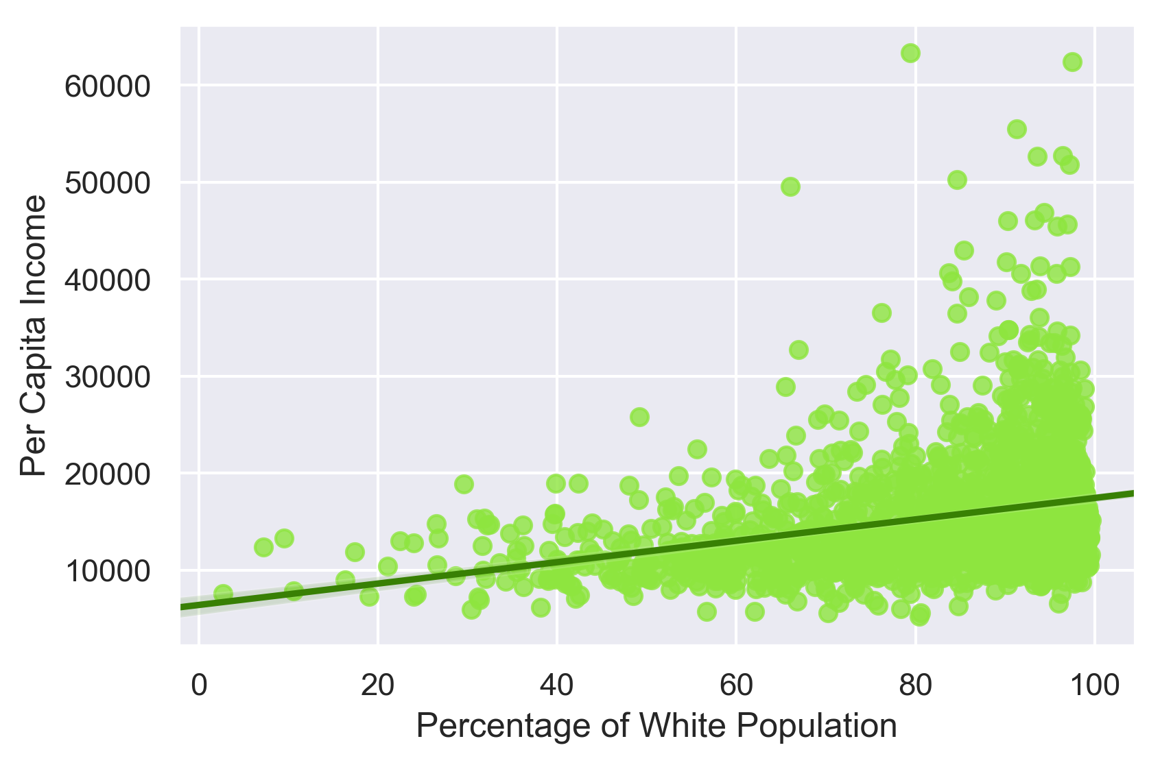
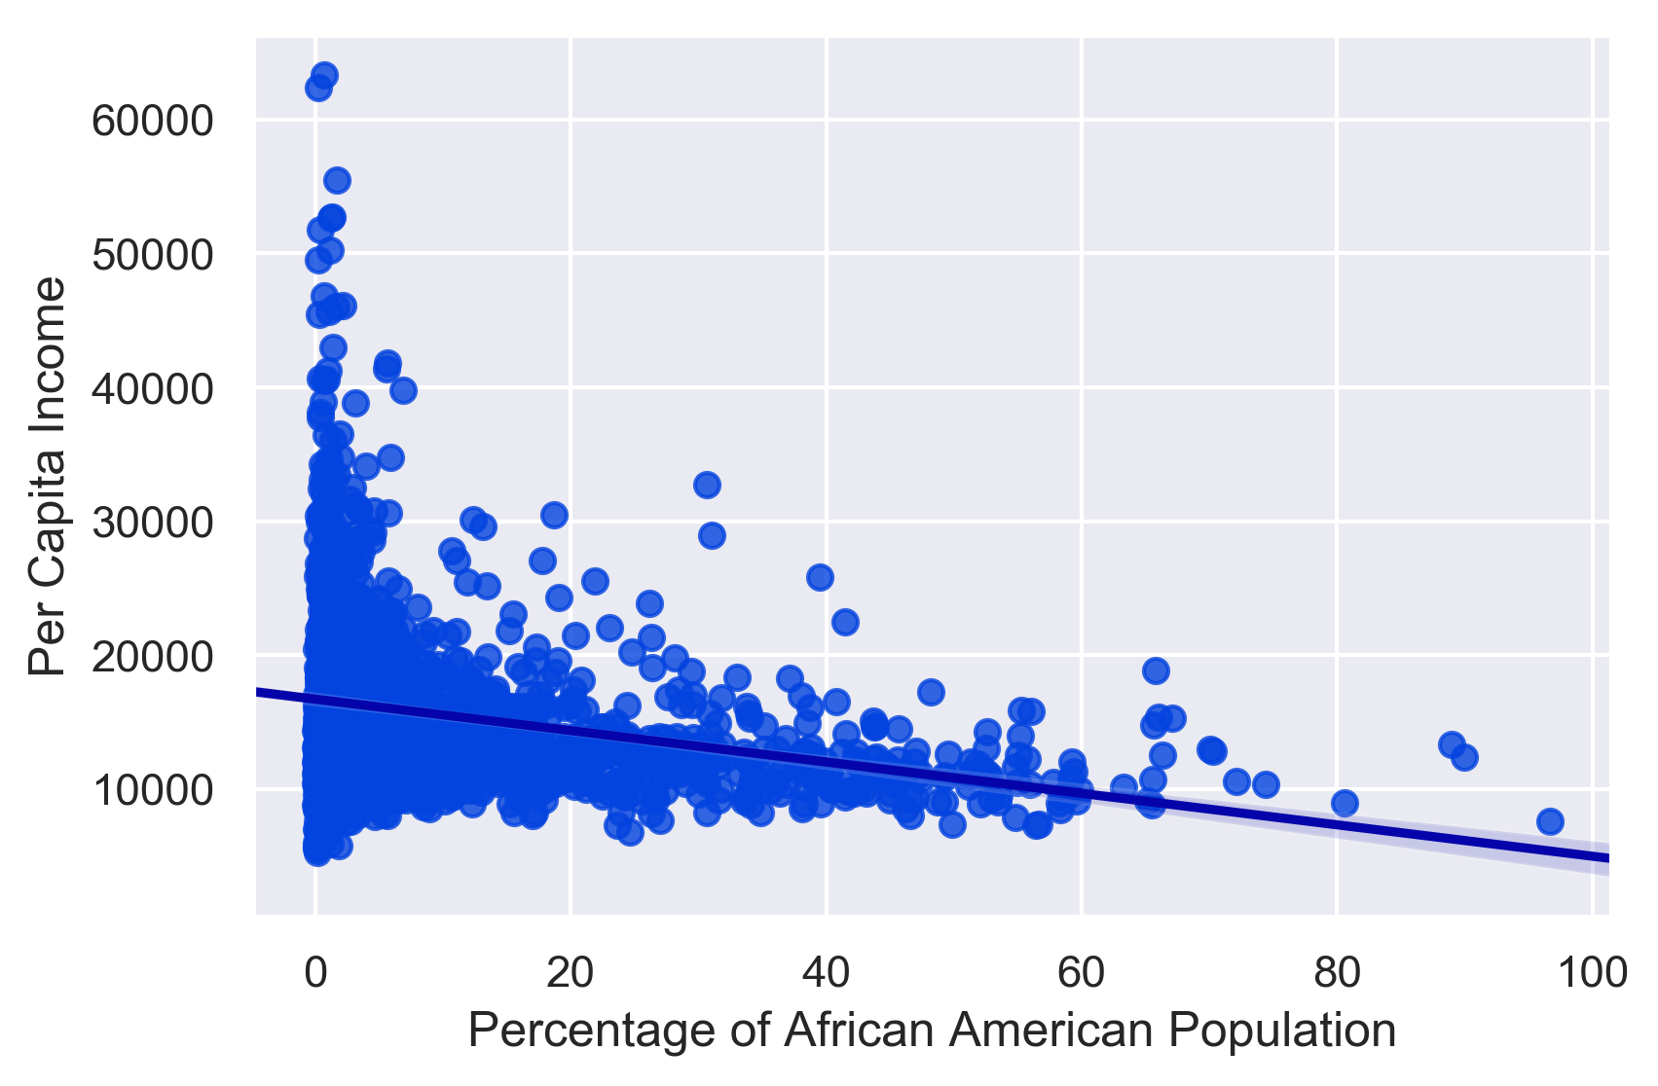
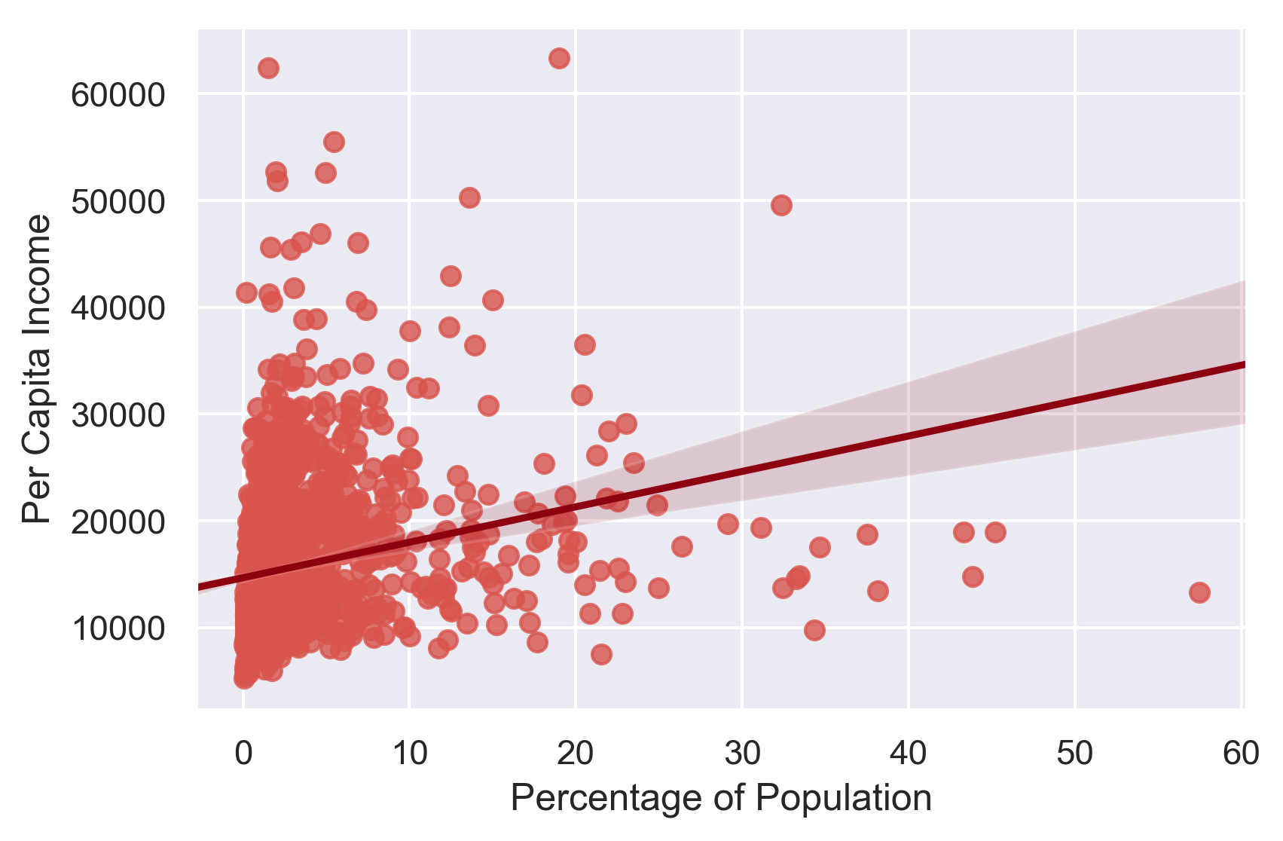
Median Income per Race Percentage of Population

